Slide 1

Vel Tech Rangarajan Dr. Sagunthala R&D Institute of Science and Technology
School of Computing
Department of Computer Science and Engineering
10211CS224 / FULL STACK APPLICATION DEVELOPMENT (JAVA)
PROJECT REVIEW : MILESTONE PROJECT – 1
Date: 04-03-2026
End-to-End Event Lifecycle & Ticketing Platform
SDG: SDG No – SDG Title(Example: SDG 4 – Quality Education)
Presented By:
S.Swamy reddy– VTU26270 – Reg.No.23UECS0500
Courses Handling Faculty:
Dr. M.Mageshwari – M.E.PH.D

Slide 2
INTRODUCTION
Background of the Problem Event organizers often rely on fragmented tools for promotion, ticketing, payments, and check-ins, leading to inefficiencies and data silos across the event lifecycle.
Why This Project Is Important An end-to-end platform streamlines planning, sales, and post-event analytics in one integrated system, reducing operational complexity and errors.
Real-World Relevance From global conferences like TED events to large-scale festivals such as Coachella Valley Music and Arts Festival, organizers need scalable, secure, and user-friendly ticketing solutions.
Brief Overview of the System The platform manages event creation, marketing, ticket sales, secure payments, QR-based check-ins, real-time dashboards, and attendee engagement in a centralized web and mobile interface.
1
2
3
4
5
6
7
8
9

Slide 3
PROBLEM STATEMENT
1
In the current event industry, organizers depend on multiple disconnected platforms for registration, ticketing, payments, and attendee management. This fragmentation creates data silos, operational delays, and higher chances of errors. Manual verification and on-site ticket validation often cause long queues and poor attendee experience. Limited real-time analytics restrict organizers from making informed decisions during events. Security risks such as ticket duplication and payment fraud further complicate operations. Small and mid-scale organizers especially struggle with cost-effective, scalable solutions. There is a need for a unified, automated End-to-End Event Lifecycle & Ticketing Platform. Such a system would improve efficiency, accuracy, transparency, and overall event management performance.
2
3
4
5
6
7
8
9

Slide 4
OBJECTIVE(S)
To design and develop a secure, scalable End-to-End Event Lifecycle & Ticketing Platform integrating event creation, ticket sales, payments, and attendee management in a single system.
To implement real-time analytics and automated QR-based validation to improve operational efficiency and reduce check-in time by at least 40%.
1
2
3
4
To evaluate the system’s performance in terms of transaction accuracy, system response time, and user satisfaction, ensuring at least 99% payment reliability and high usability ratings.
5
6
7
8
9

Slide 5
PROPOSED SYSTEM
The system provides a unified web and mobile platform integrating event creation, ticketing, secure payments, marketing, and attendee management.
It eliminates fragmented tools by centralizing all event lifecycle processes into a single database and dashboard.
Automated QR-code generation and real-time validation reduce manual verification and long check-in queues.
Built-in real-time analytics enable organizers to track ticket sales, revenue, and attendance instantly.
Secure payment gateway integration minimizes fraud and ensures reliable transactions.
Cloud-based architecture ensures scalability for small, mid-scale, and large events.
Role-based access control enhances data security and administrative efficiency.
Compared to existing systems, it offers end-to-end automation, improved accuracy, reduced operational cost, and better user experience.
1
2
3
4
5
6
7
8
9

Slide 6
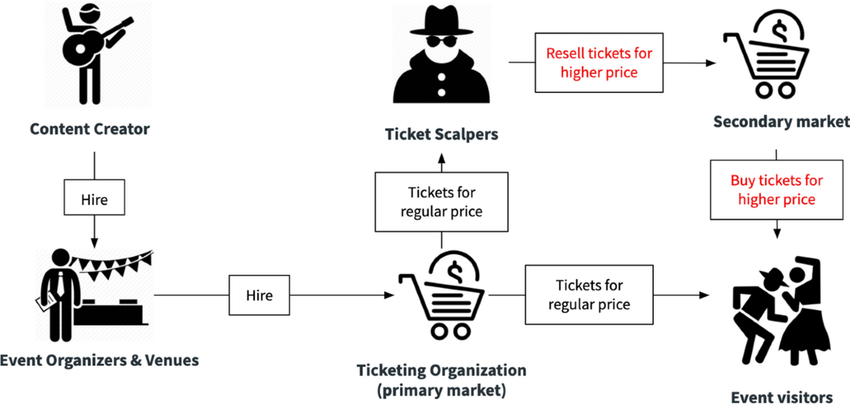
PROPOSED SYSTEM ARCHITECTURE
1
Block Diagram (Text Representation):
Input: User registrations, event details, ticket selections, payment information, and admin configurations.
Processing: User authentication, ticket generation (QR codes), payment verification, seat allocation, data validation, and real-time analytics computation.
Database: Stores user profiles, event details, ticket records, transaction logs, and attendance data securely.
Output: E-tickets with QR codes, payment confirmations, sales reports, analytics dashboards, and check-in status updates.
2
3
4
5
6
7
8
9

Slide 7
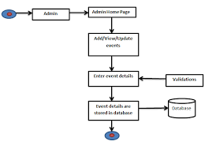
WORKFLOW
1
2
3
4
5
6
7
8
9

Slide 8
TECHNOLOGIES USED
Technologies Used – End-to-End Event Lifecycle & Ticketing Platform
🔹 Frontend
React.js
React Native (Mobile App)
HTML5, CSS3, Tailwind CSS
🔹 Backend
Node.js
Express.js
REST APIs
JWT Authentication
🔹 Database
PostgreSQL
Redis (Caching & Seat Locking)
🔹 Payment Integration
Stripe / PayPal
🔹 DevOps & Cloud
Git & GitHub
Docker
AWS / Azure
CI/CD Pipelines
1
2
3
4
5
6
7
8
9

Slide 9
MODULE DESCRIPTION
Project Modules
Module 1: User & Authentication Management
Handles user registration, login, role-based access (Admin, Organizer, Attendee), profile management, and secure authentication using JWT/OAuth.
Module 2: Event Management
Allows organizers to create, update, publish, and manage events including venue details, schedules, ticket types, pricing, and seat allocation.
Module 3: Ticketing & Payment Processing
Manages ticket booking, real-time seat locking, secure payment integration, order confirmation, QR code generation, refunds, and cancellations.
Module 4: Analytics & Reporting
Provides sales reports, revenue tracking, attendee insights, event performance metrics, and dashboard analytics for organizers and admins.
1
2
3
4
5
6
7
8
9

Slide 10
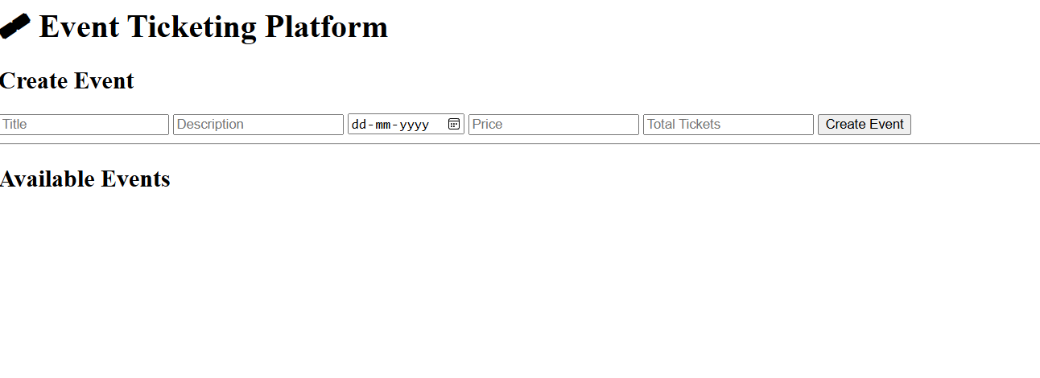
IMPLEMENTATION SCREENSHOTS
.
1
2
3
4
5
6
7
8
9

Slide 11
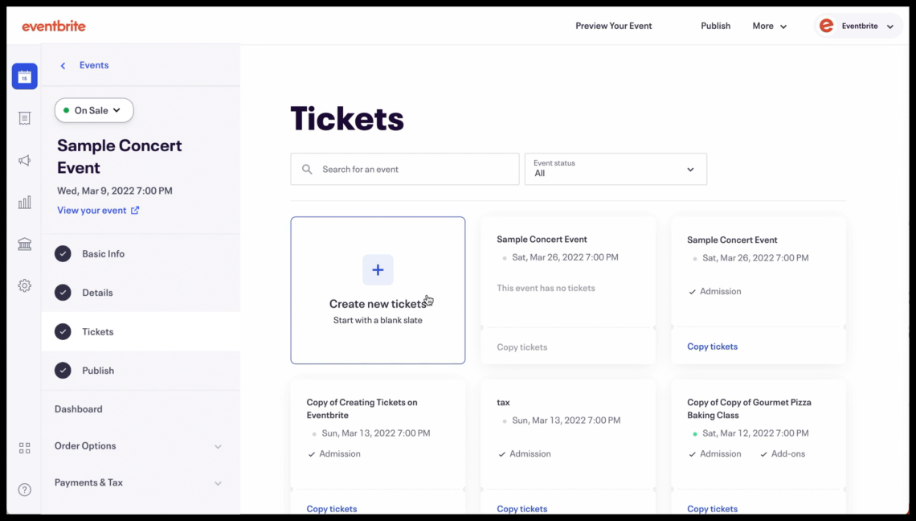
IMPLEMENTATION SCREENSHOTS
1
2
3
4
5
6
7
8(A)
9

Slide 12
IMPLEMENTATION SCREENSHOTS
1
2
3
4
5
6
7
8(B)
9

Slide 13
IMPLEMENTATION SCREENSHOTS
1
2
3
4
5
6
7
8(C)
9

Slide 14
ADVANTAGES & LIMITATIONS
Advantages
🎟️ End-to-End Event Management (creation to check-in)
💳 Secure Online Payments & Automated Ticketing
⚡ Real-Time Seat Booking & Availability Tracking
📊 Analytics & Sales Insights for Organizers
🌍 Accessible Anywhere (Web & Mobile Support)
🔐 Role-Based Access & Secure Authentication
📈 Scalable for Small to Large Events
Limitations
🌐 Requires Stable Internet Connectivity
💰 Payment Gateway Transaction Charges
🔄 High Server Load During Peak Bookings
🔒 Cybersecurity Risks if Not Properly Secured
🛠️ Maintenance & Cloud Hosting Costs
📉 Dependency on Third-Party Services (Payments, Cloud
1
2
3
4
5
6
7
8
9

Slide 15
Thank you

